Slide 1
Phylogenetic Assessment of the Fictional Races of Tolkien Across Multiple Fictional Universes
Jermaine Mahguib
EEOB 563 Molecular Phylogenetics
Iowa State University

Slide 2
Overview
The high fantasy races of Tolkien
Adaptations of Tolkien archetypes in media
Phylogenetic questions
Character state dataset
Outgroups
Analytical methodology
Phylogenetic Trees
Some conclusions

Slide 3
The High Fantasy Races of Tolkien
Concepts not original to Tolkien
Elves, gnomes, dwarves, fairies, goblins, orcs and ogres all have roots in human folklore
Tolkien largely credited for the modern popular culture conception

Slide 4
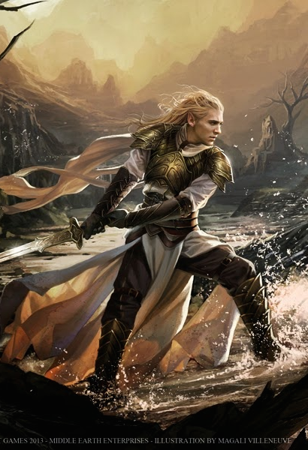
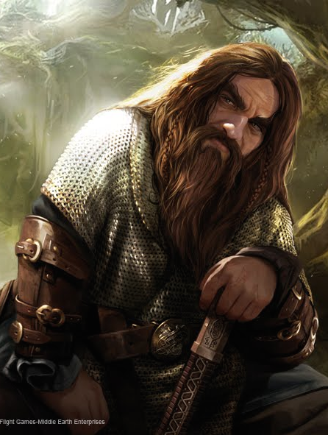
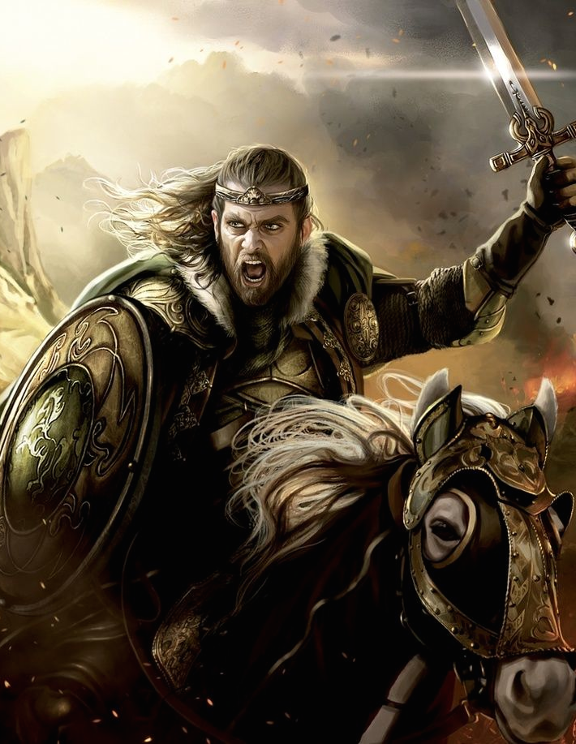
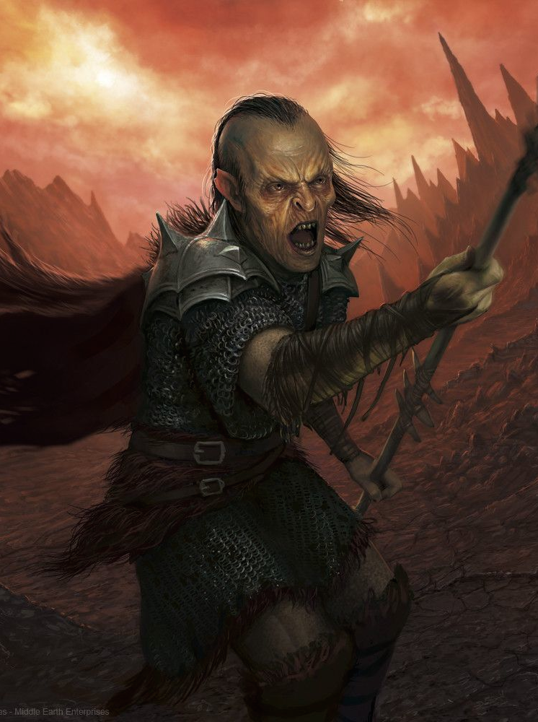
The High Fantasy Races of Tolkien

Slide 5
Adaptation of Tolkien Archetypes in Media
Tolkien conception of these militarized peoples heavily adapted in modern fiction
Many intellectual properties (IPs) based on them (# of taxa used shown in parentheses):
The Forgotten Realms (5)
The Elder Scrolls (5)
Warcraft (5)
Warhammer (5)
Warhammer 40K (5)
The Witcher (3)

Slide 6
Phylogenetic Questions
How much have adaptations of Tolkien’s core fictional races changed across IPs?
Have the changed more or less in particular respects?

Slide 7
Character State Dataset
Established total of 70 character traits
Traits varied in number of states from 2 to 7
Traits divided into three categories:
Physiological (32 traits)
Behavioral (20 traits)
Archetypal (18 traits)

Slide 8
Character State Dataset
Examples of traits from each category…
Physiological Traits:
Height
Strength
Longevity
Supernatural Aptitude
Behavioral Traits:
Adaptability
Aggression
Impulsivity
Joviality
Archetypal Traits:
Racial Age
Prevalence
Prophecy Entanglement
Joviality

Slide 9
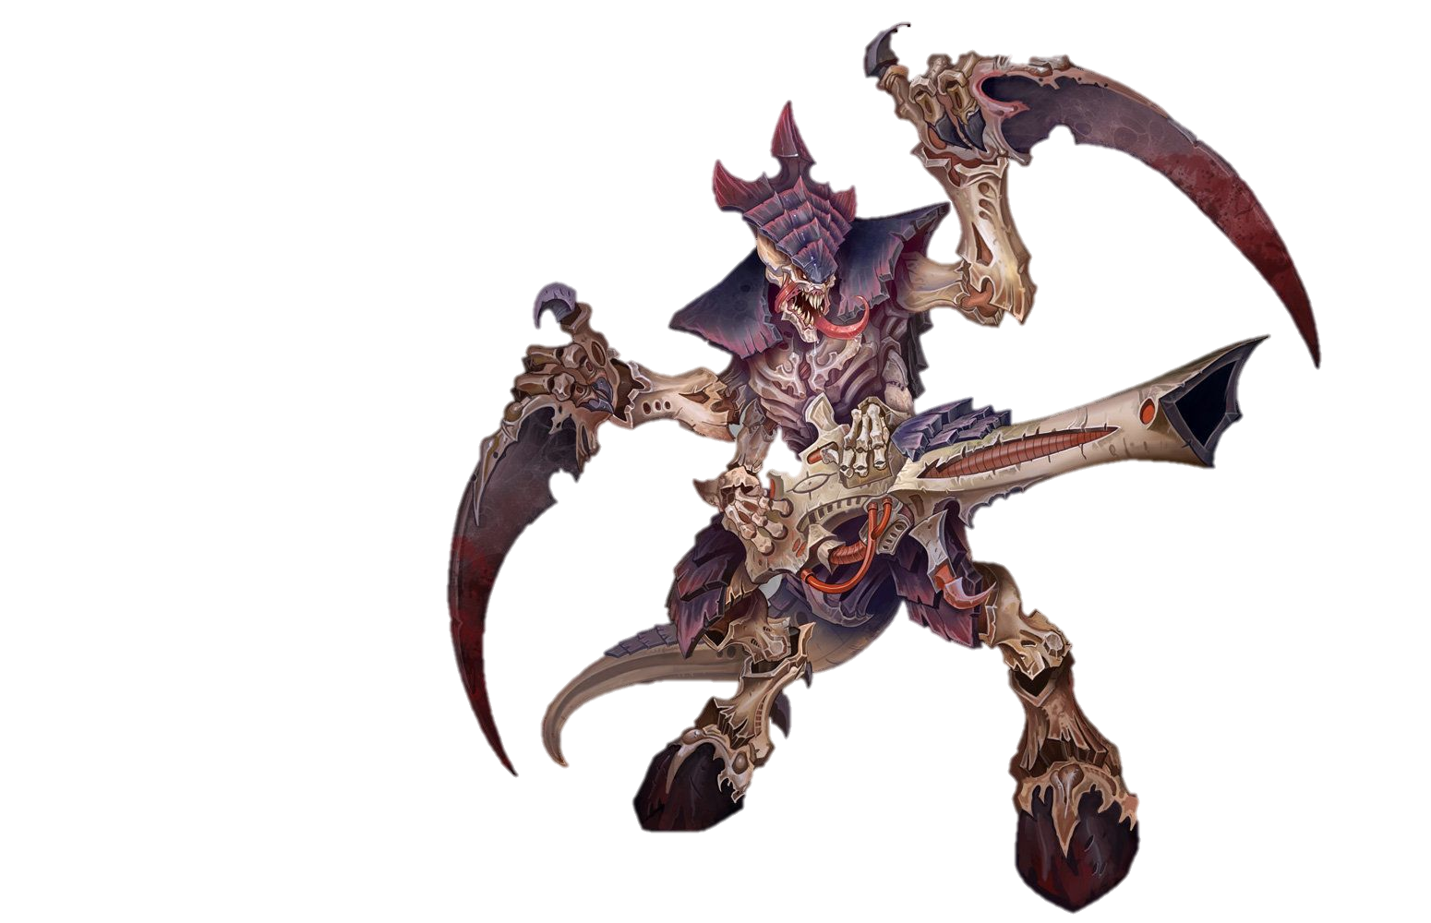
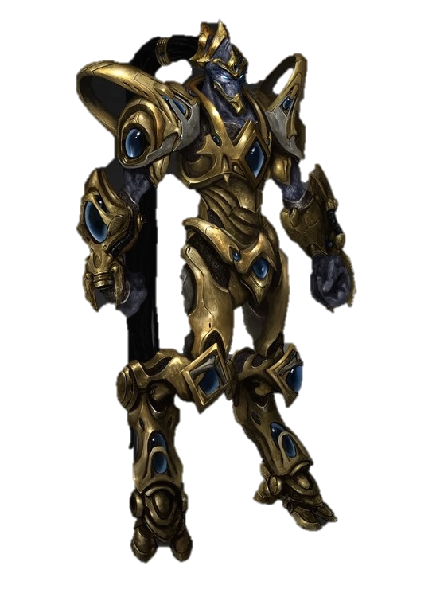
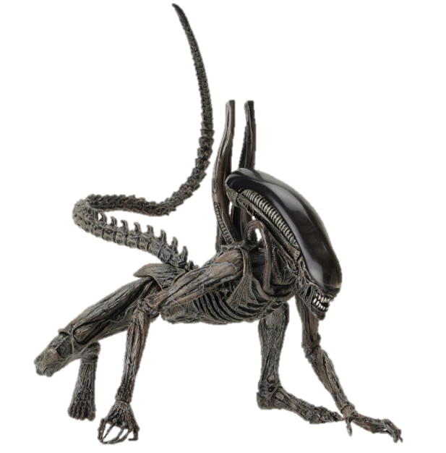
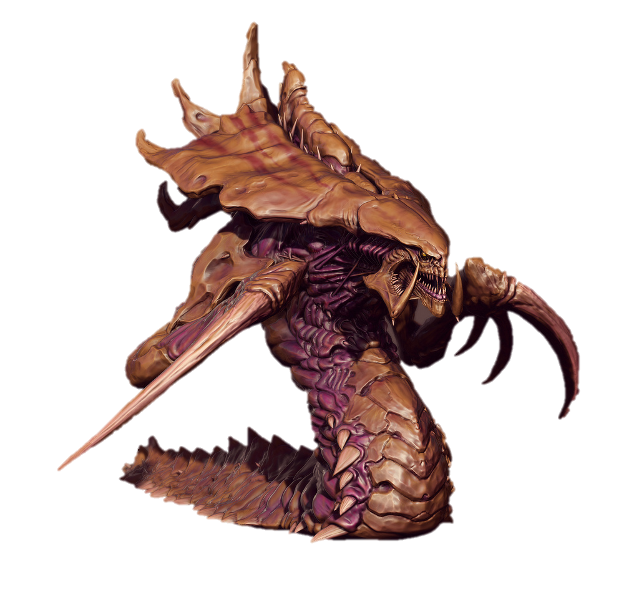
Outgroups
Four additional fictional races identified for potential use as outgroups:
Protoss
Zerg
Tyranids
Xenomorphs

Slide 10
Analytical Methodology
Two sets of maximum likelihood analyses conducted:
Concatenated character state alignment
Categorical character state alignments

Slide 11
Analytical Methodology
Concatenated character state alignment
Four analyses conducted using different sets of outgroups
1000 trees searched
MULTI#_MK model
1000 bootstrap replicates
Tested for bootstrap convergence

Slide 12
Analytical Methodology
Categorical character state alignments
Six analyses conducted using different sets of outgroups
400 trees searched
MULTI#_MK model
1000 bootstrap replicates
Tested for bootstrap convergence

Slide 13
Results

Slide 14
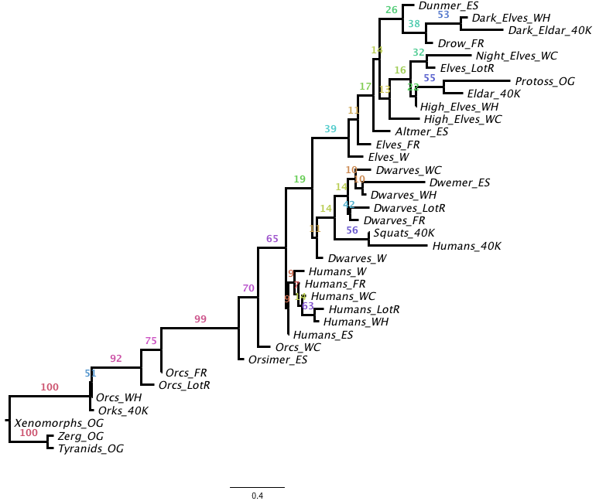
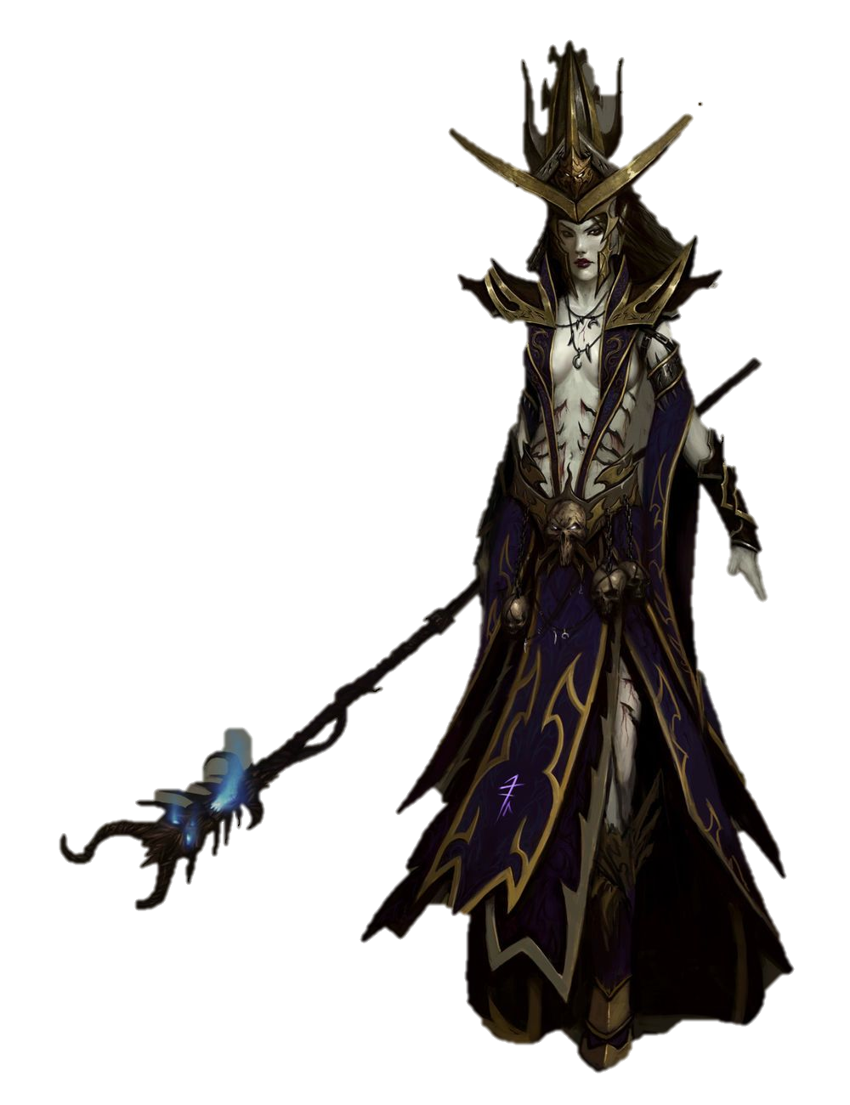
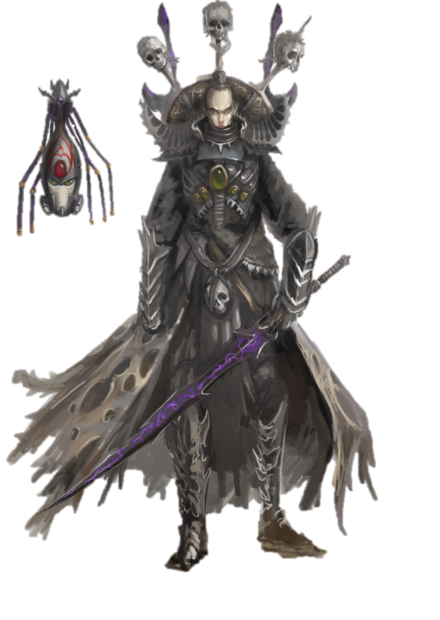
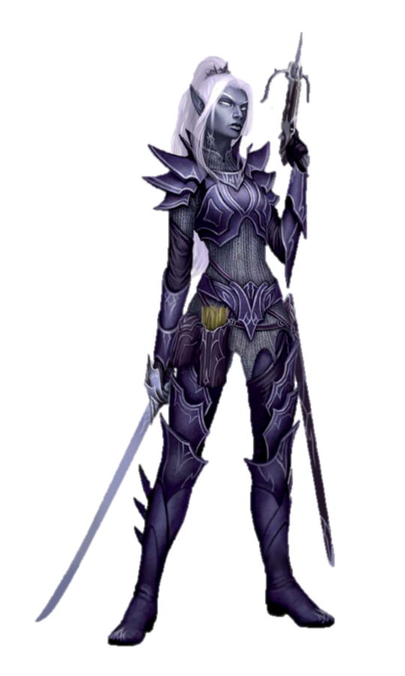
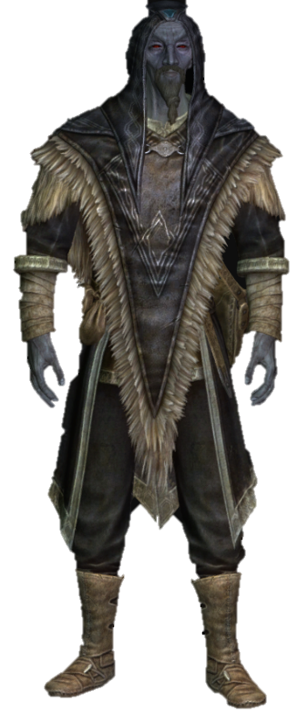
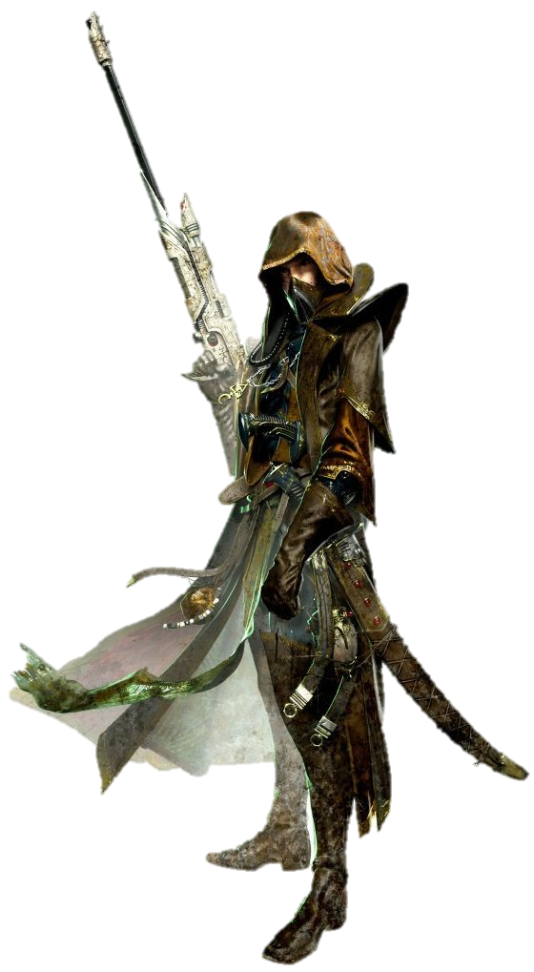
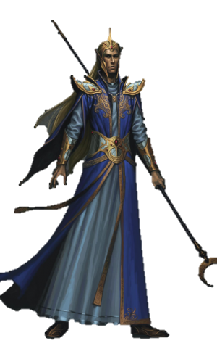
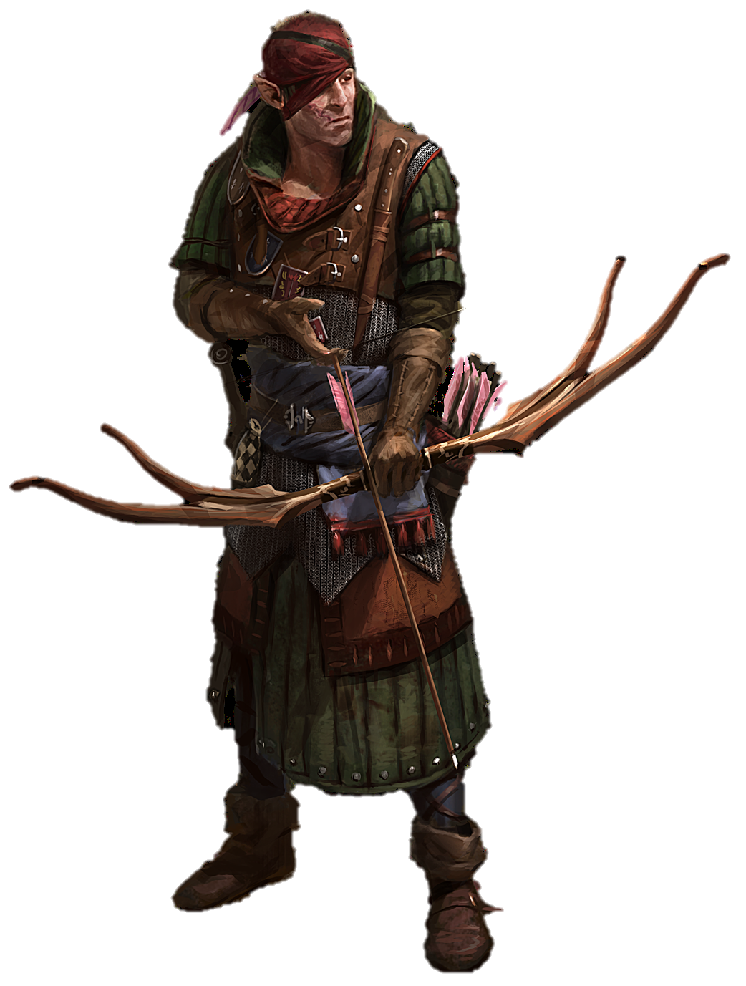
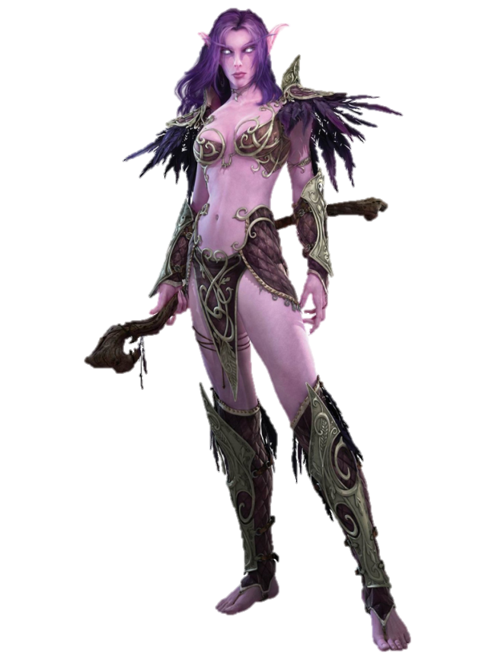
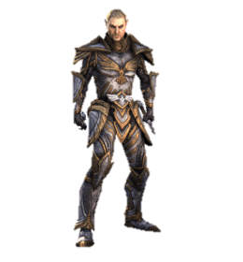
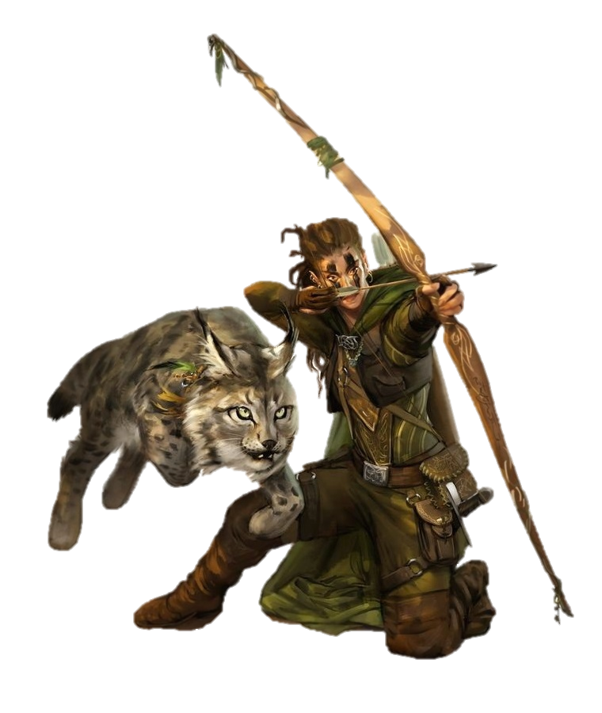
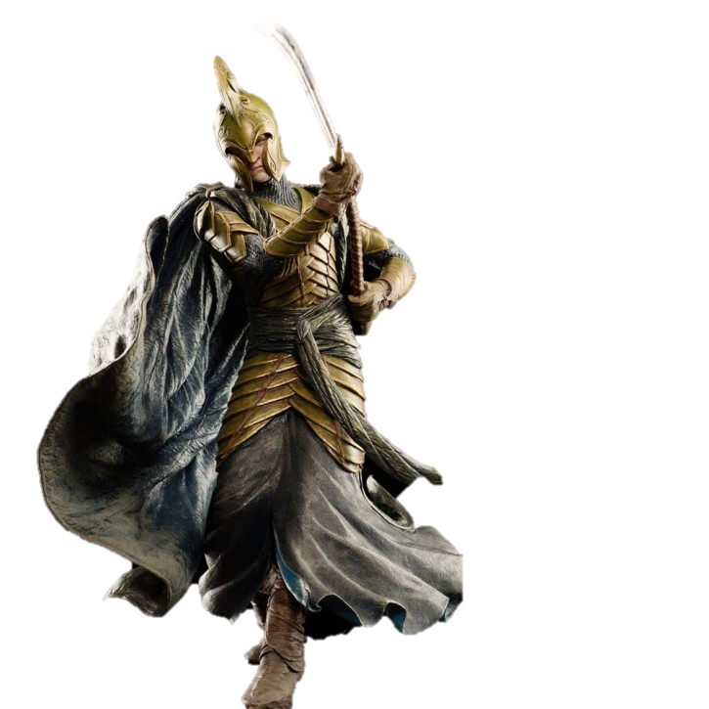
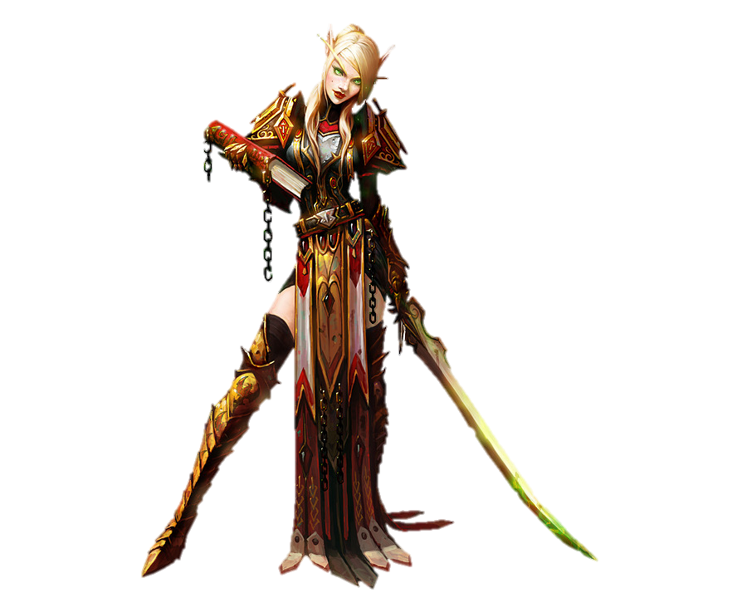
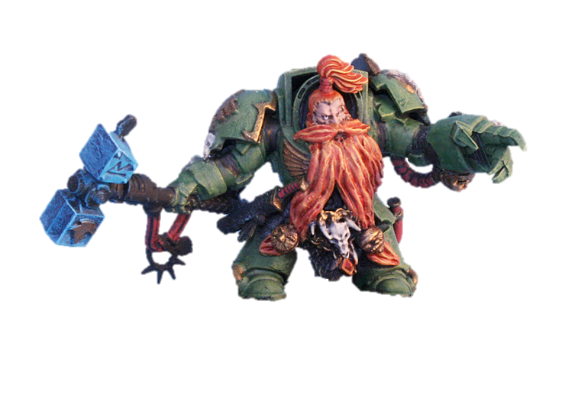
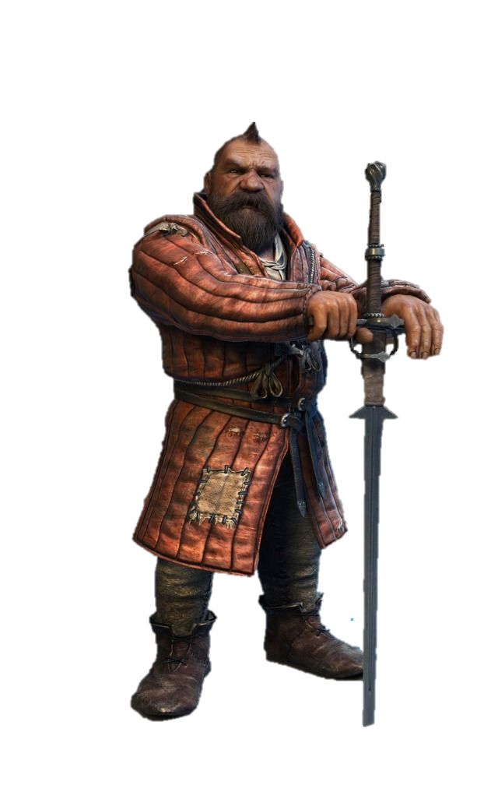
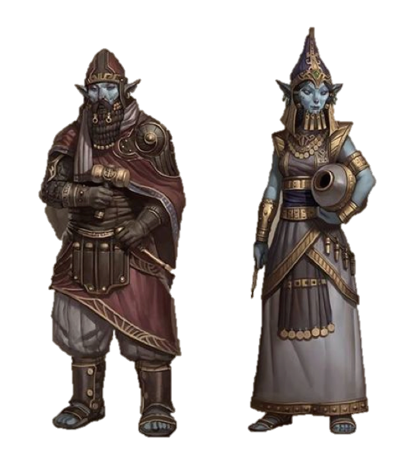
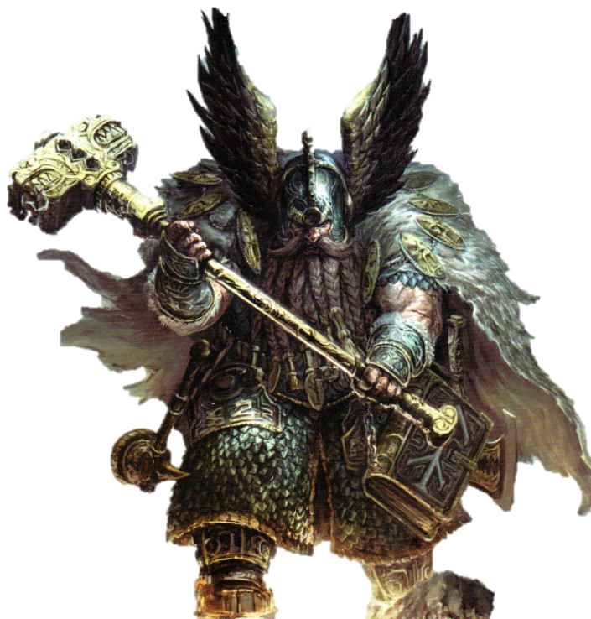
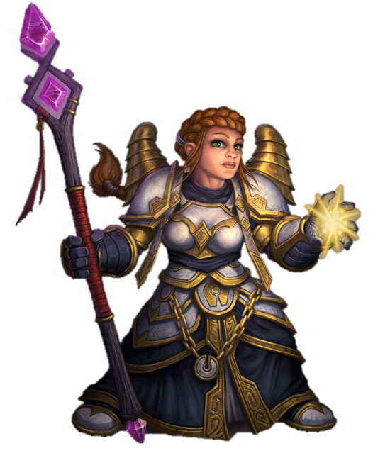
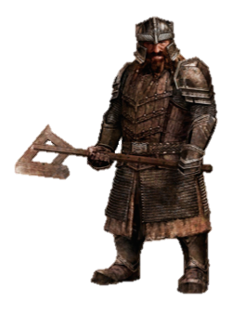
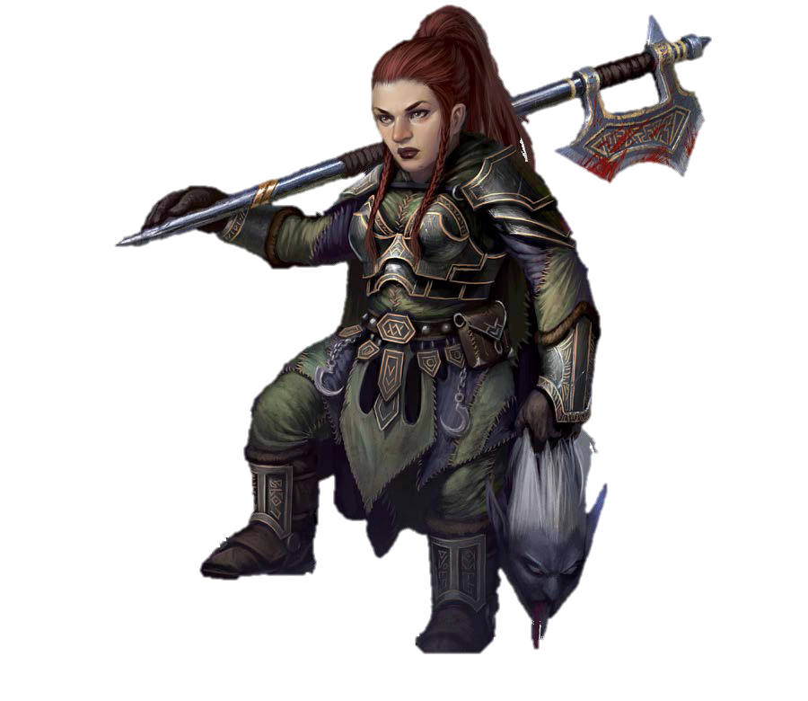
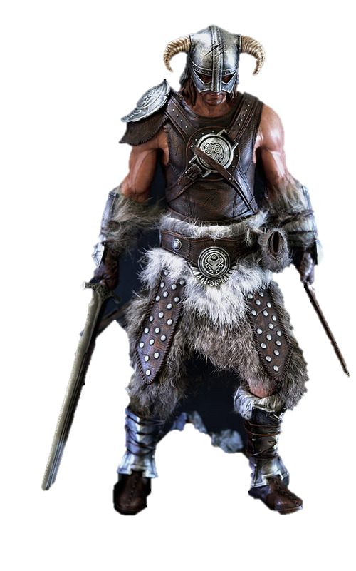
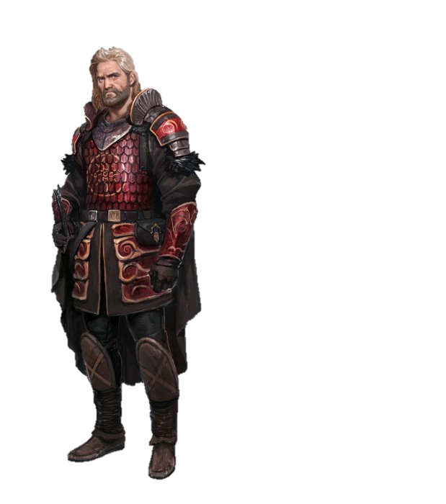
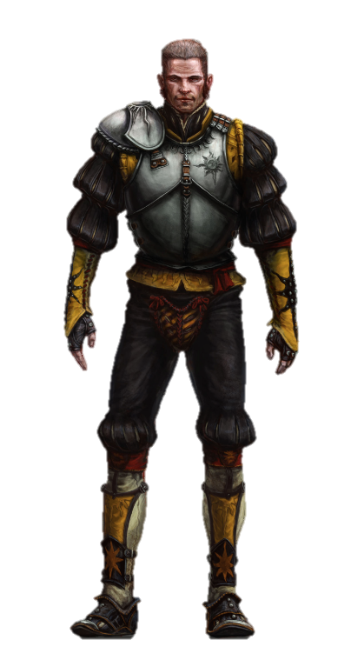
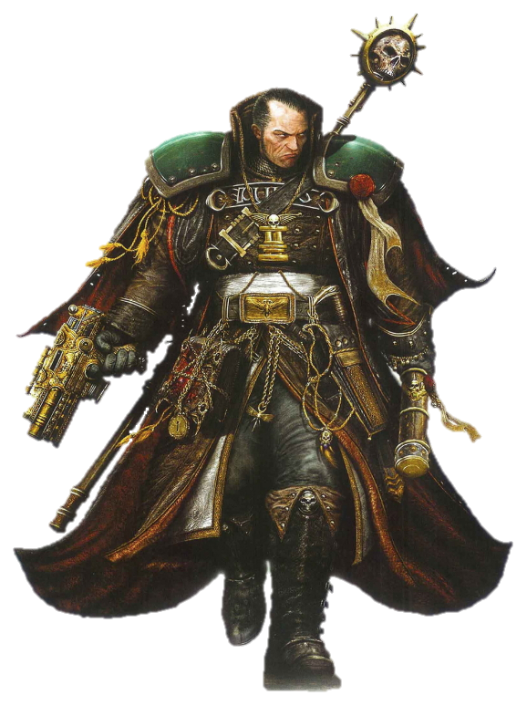
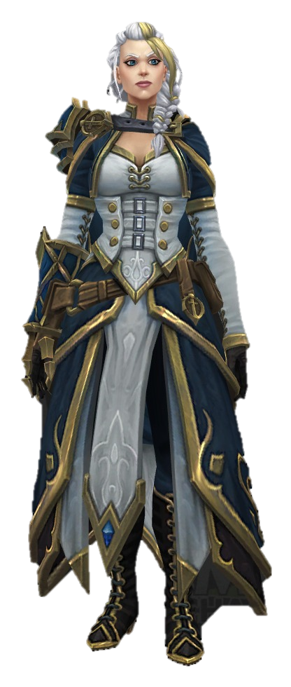
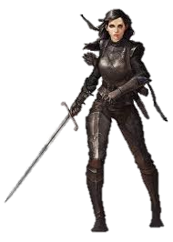
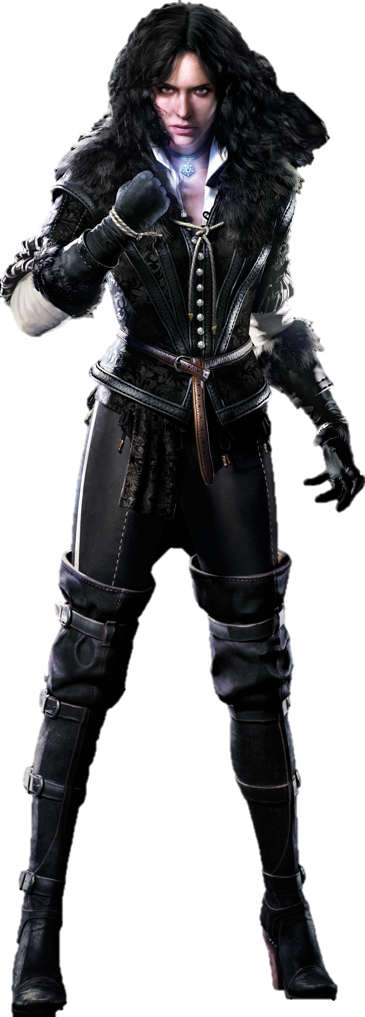
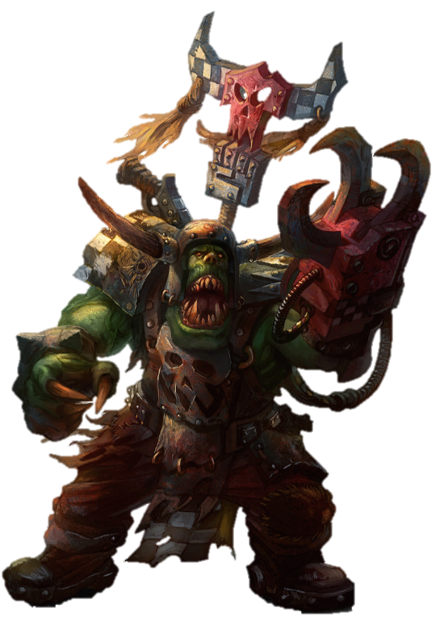
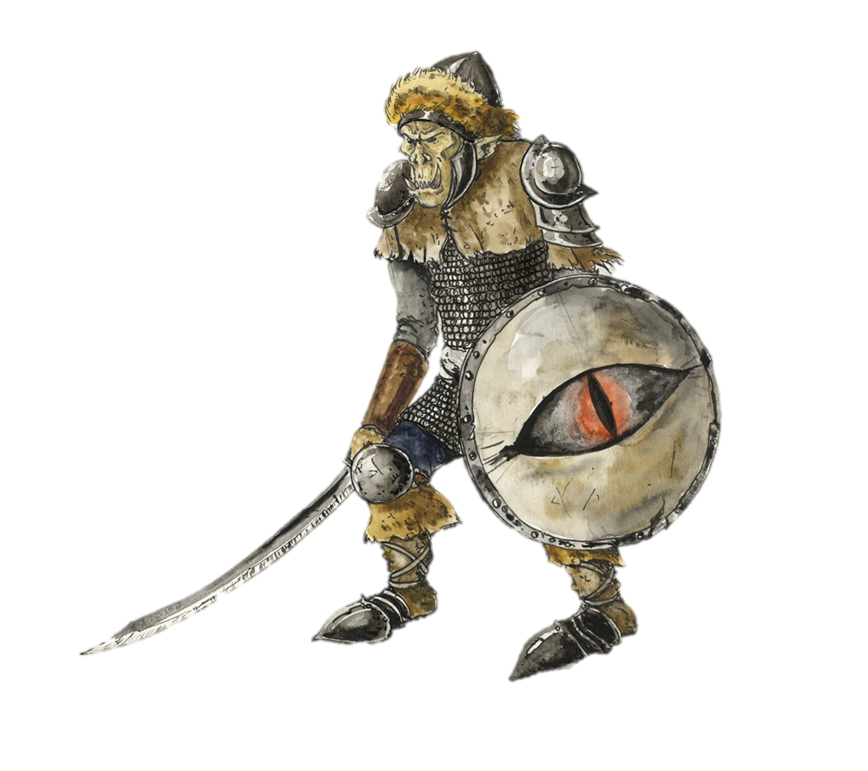
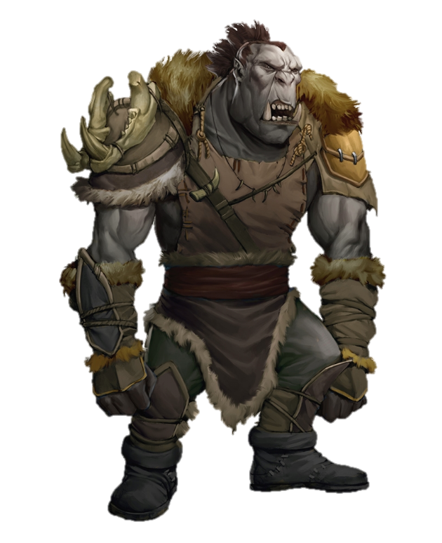
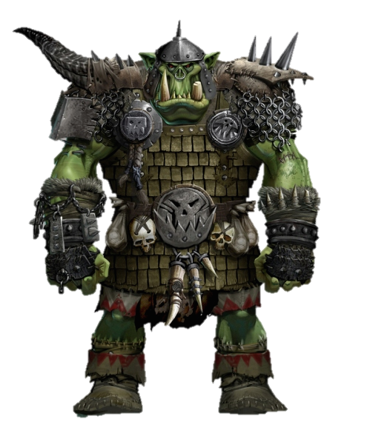
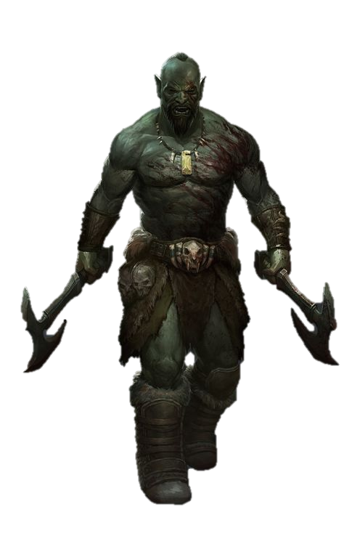
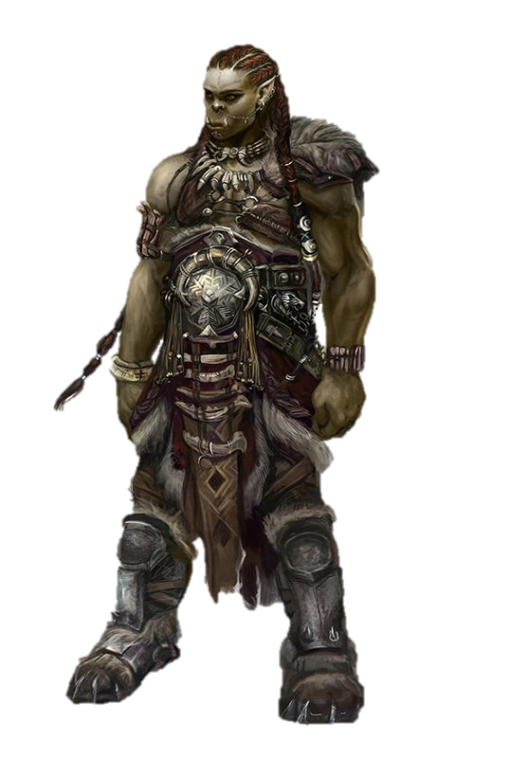

Slide 15
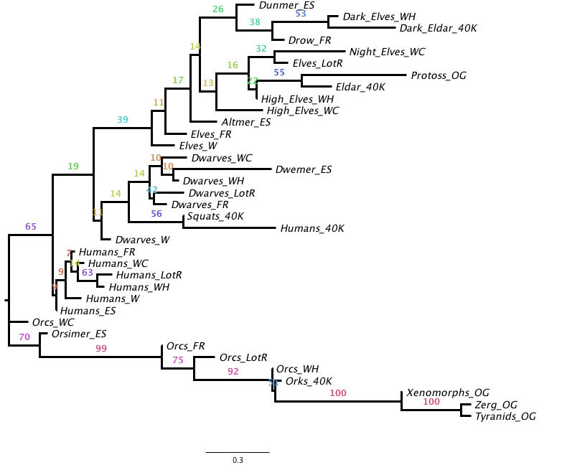

Slide 16
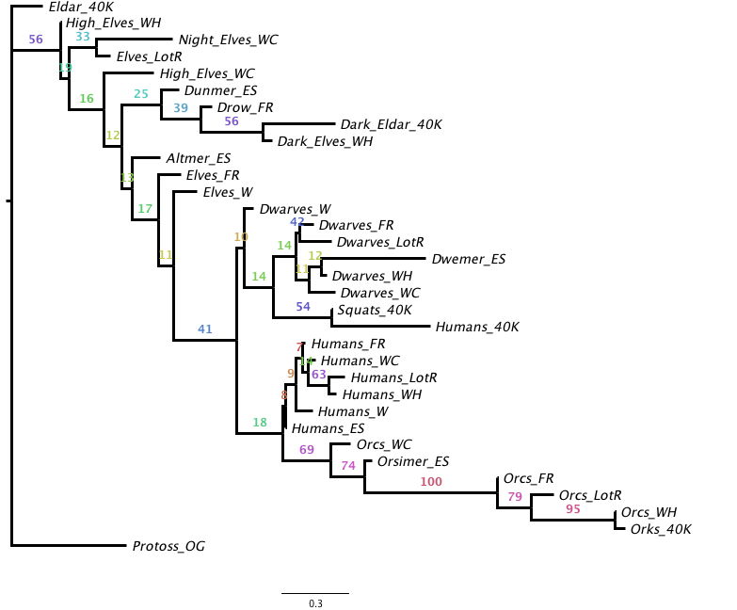

Slide 17
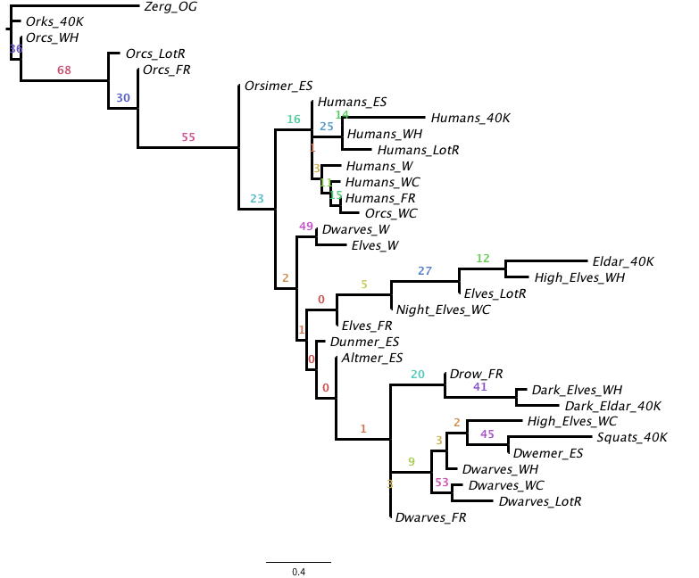
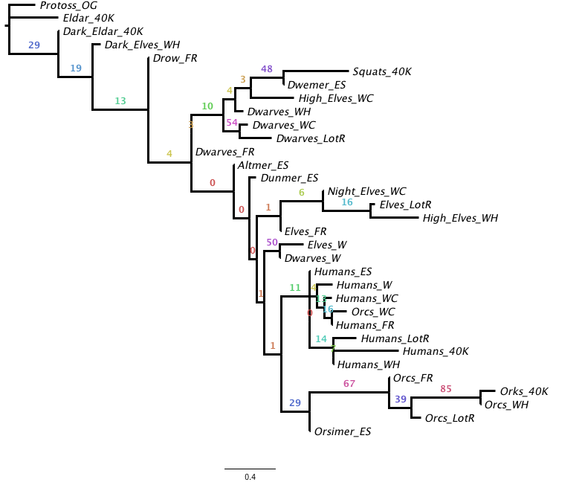
B
A

Slide 18
General Conclusions
Despite numerous creative liberties taken by IP producers, iterations of Tolkien’s core high-fantasy races form distinct clades
All traits considered, many variants similar across universes, although they may vary more in terms of categorical traits

